Slide 1
Normalization

Slide 2
What is normalization
We need some formal measure of why one grouping of attributes into a relational schema may be better than another
Measure of “goodness” or quality of the design
An analytical technique used during logical database design
Offers a strategy for constructing relations and identifying keys

Slide 3
Role of Normalization
Minimize Redundancy – Duplicates
Remove Anomalies
Update
Insert
Delete

Slide 4
History
Patterns to identify redundancy in data.
Edger F. Codd, the inventor of the relational model, introduced the concept of normalization in 1970. i.e. 1st NF
2nd & 3rd NF in 1971.
Codd and Raymond F. Boyce defined BCNF in 1974.

Slide 5
Normal Forms
1 NF
2 NF
3 NF
4 NF
5 NF
Normal forms are INCREMENTAL

Slide 6
1 NF
Eliminate repeating groups, attributes must have only atomic values
Employee
Emp_id | name | salary | phone
101 | Abc | 10000 | 9821011111, 9821044444
102 | LMN | 120000
103 | XYZ | 78000 | 0226201111, 0226243333, 9820012345
Problems with the above design ?

Slide 7
1 NF
Soln 1:
Emp_id | phone | name | salary
101 | 9821011111 | Abc | 10000
101 | 9821044444 | Abc | 10000
102 |  | LMN | 120000
103 | 0226201111 | XYZ | 78000
103 | 0226243333 | XYZ | 78000
103 | 9820012345 | XYZ | 78000
Problems with the above design ?
Redundancy
Insertion anomalies
Deletion anomalies
Updation anomalies

Slide 8
1 NF
Soln 2:
Emp_id | name | salary | phone1 | phone2 | phone3
101 | Abc | 10000 | 9821011111 | 9821044444
102 | LMN | 120000
103 | XYZ | 78000 | 0226201111 | 0226243333 | 9820012345
Problems with the above design ?

Slide 9
1 NF
Soln 3:
Emp_id | name | salary
101 | Abc | 10000
102 | LMN | 120000
103 | XYZ | 78000
Emp_id | phone
101 | 9821011111
101 | 9821044444
103 | 0226201111
103 | 0226243333
103 | 9820012345

Slide 10
Functional Dependency
Require that the value for a certain set of attributes determines uniquely the value for another set of attributes.
Functional dependencies define properties of the schema and not of any particular tuple in the relation.
The functional dependency
α → β

Slide 11
Functional Dependency
Employee project details
Emp_id | Project_no | Emp_name | salary | Project_name
101 | 1 | ABC | 10000 | ProjA
101 | 2 | ABC | 10000 | ProjB
102 | 3 | LMN | 120000 | ProjC
103 | 1 | XYZ | 78000 | ProjA
103 | 2 | XYZ | 78000 | ProjB
Emp_id -> {emp_name, salary}
Project_no -> project_name
Emp_id,project_no -> emp_name,salary,project_name
Emp_name -> emp_id, salary, project name ???

Slide 12
2 NF
Remove partial dependency.
Eliminate fields that are facts about only a subset of the key so that all non-key fields are fully functionally dependent on the primary key
A relation is said to be in 2NF if and only if it is in 1 NF and every non-key attribute is fully functionally dependent on the primary key.

Slide 13
2 NF
Employee project details
Emp_id | Project_no | Emp_name | salary | Project_name
101 | 1 | ABC | 10000 | ProjA
101 | 2 | ABC | 10000 | ProjB
102 | 3 | LMN | 120000 | ProjC
103 | 1 | XYZ | 78000 | ProjA
103 | 2 | XYZ | 78000 | ProjB
Problems with the above design ?
Redundancy
Insertion anomalies
Deletion anomalies
Updation anomalies

Slide 14
2 NF
Employee
Emp_id | name | salary
101 | Abc | 10000
102 | LMN | 120000
103 | XYZ | 78000
Project
Project_no | Project_name
1 | ProjA
2 | ProjB
3 | ProjC
Employee_Project
Emp_id | Project_no
101 | 1
101 | 2
102 | 3
103 | 2
103 | 3

Slide 15
3NF
Remove transitive dependency.
A relation should not have a non-key attribute functionally determine determined by another non-key attribute.
Every non-key attribute must provide a fact about the key, the whole key, and nothing but the key.

Slide 16
3 NF
Emp_id | Emp_name | salary | Dept_id | Dept_name | Deptmgr_empid
101 | Abc | 10000 | A | DeptA
102 | LMN | 120000 | A | DeptA | 101
103 | XYZ | 78000 | B | DeptB
Emp_id -> {emp_name, salary, dept_id, dept_name, deptmr_empid} dept_id -> {dept_name, deptmgr_empid}

Slide 17
3 NF
Employee
Emp_id | Emp_name | salary | Dept_id
101 | Abc | 10000 | A
102 | LMN | 120000 | A
103 | XYZ | 78000 | B
Department
Dept_id | Dept_name | Deptmgr_empid
A | DeptA | 101
B | DeptB | 103

Slide 18
Denormalization
Process of attempting to optimize the read performance of a database by adding redundant data.
Used in Decision Support Systems.
Examples-
Materialized Views
Data Warehouse/Marts
Prebuilt Aggregation Or OLAP Cubes

Slide 19
Classroom exercise 1
Suppose you are given a relation R = (A,B,C,D,E) with the following functional dependencies: {CE -> D,D -> B,C -> A}.
Find all candidate keys.
Identify the best normal form that R satisfies (1NF, 2NF, 3NF)

Slide 20
Classroom exercise 1
Answer.
The only key is {C,E}
The relation is in 1NF

Slide 21
Classroom exercise 2
You are given the following set of functional dependencies for a relation R(A,B,C,D,E,F), F = {AB -> C,DC -> AE,E -> F}.
What are the keys of this relation?
Is this relation in 3NF? If not, explain why by showing one violation.

Slide 22
Classroom exercise 2
Answer
{A,B,D} and {B,C,D}
No, all functional dependencies are actually violating this. No dependency contains a superkey on its left side.

Slide 23
Classroom exercise 3
Football World Cup Database Design
There are 32 teams.
Each team has its own attributes i.e.
Country
Manager
Physiotherapist…
Each team has “n” no of players
Each player has its own attributes i.e.
Name
Age
Player Position…

Slide 24
Classroom exercise 3…
There are 8 groups in the tournament
Each group has 4 teams
Transactions/Operations –
Match Schedule/Statistics
Teams
Date
Start Time
Venue
Result
Goal Scorer
Goal Time
Ball Possession/Shots on Target
Corners
Referee
Goal Type

Slide 25
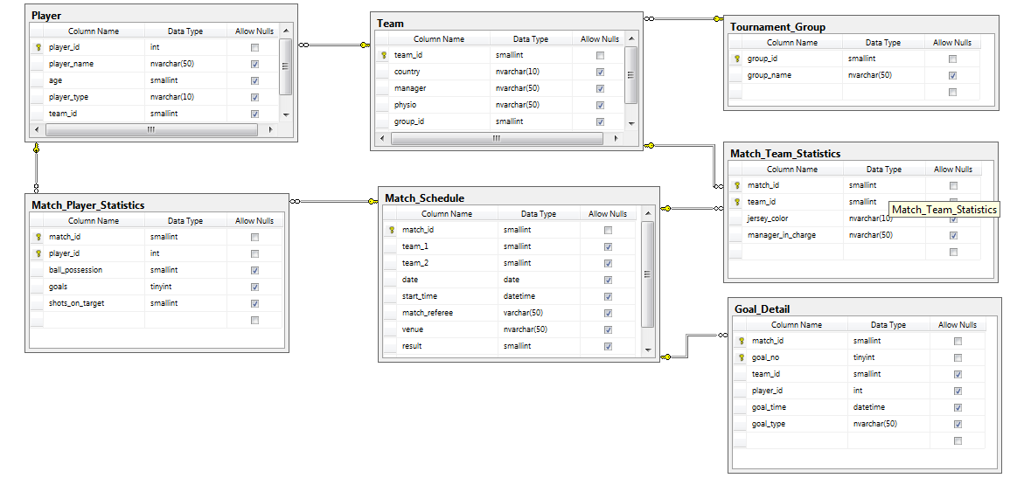
Classroom exercise 3…
Design

Slide 26
Classroom exercise 3…
Top goal scoring player.
Top 5 players by ball possession.
Top 5 teams by ball possession.
Quickest goal
Time
Team
Player

